Slide 1

Hilton Hotels & Resorts
Guided by:
Abhishek Wavhal
Presented by:
Abhinav Kanaujia

Slide 2
Purpose of presentation:-
Summarize key insights and recommendations derived from data analytics throughout the presentation.
Encourage further data analysis and ongoing data-driven decision-making to drive continuous improvement.
Use data analytics to personalize contact information based on audience preferences and engagement history.
Utilize operational data to showcase the utilization rates of various hotel facilities and services.

Slide 3
Key Contents
Condensed Project
Attribution Modeling
Dilemma Presentation
Data Cleaning Process
Data Visualization and Analysis
Conclusion
Closure

Slide 4
Condensed Project
Project Overview :
Hilton offers two distinct types of accommodations in the United Kingdom City hotels and resort hotels. Over the period from 2015 to 2017, comprehensive guest data was collected for both types of properties.
Examine of Data :
First we observed that we have approx. 32 number of column such that
Types of properties
Date of booking
Which weeks made highest number of bookings
Types of meal for guest
Average daily Rate per guest
Availability of rooms
Market segment
From which country the booking has come

Slide 5
Cleansing:
First we start with removing errors , remove duplicates values ,remove some column which are not useful ,add some column.
Transforming:
We Transform data with help with power query editor tool.
Visualization and Reporting:
We use charts , graphs, map, and other data visual element to represent data in a meaningful way.

Slide 6
Attribution Modeling
Attribution modeling is a method used in marketing and analytics to evaluate and assign credit to various touchpoints in customers journey that contribute to conversions or desired out comes ,such as customer booking weeks ,number of peoples.
By attribute modeling businesses can optimize their marketing strategies, allocate resources more effectively, and improve overall return of investment (ROI) .

Slide 7
Dilemma Presentation
Seasonality Analysis:
Booking month
Booking weeks
Booking day
Booking years
Lead time
Weekend nights

Slide 8
Guest Details:
Adult
Child
Babies
Country
Meal

Slide 9
Room and Services:
Reserved room type
Assigned room type
Car parking availability
Waiting list
Reservation Status
Previous cancelation

Slide 10
Transaction and Tariffs:
Average daily rate(ADR)
Agent
Company
Deposit type

Slide 11

Data Cleaning Process:
In data cleaning Process we stared with removing duplicate values and found that approx. 31966 values.
In next step we replace ‘NULL’ value with ‘Others’.
Add column name as Number of peoples in this column we added Adult ,Childrens and babies.
Removed column company.
Reservation date was not in Date format so we correct them.
Removed week nights column.

Slide 12
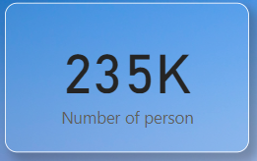
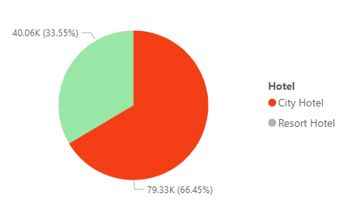
Data Visualization and Analysis:
We have 235K numbers of peoples.
Here we are compare City hotel and Resort hotel
With help of pie chart and found that approximately
66% Guests are from City Hotel and 33 % are from
Resort Hotel.
Percentage of city hotel is higher because of their
location while the percentage of Resort hotel less because
of they charge more money.

Slide 13
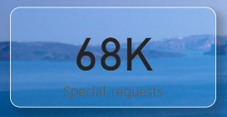
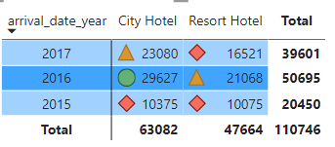
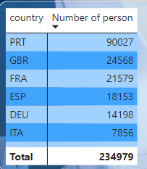
We have booked 68K special request in the last
three years.
In 2015, people made 20,450 bookings on weekend nights,
In 2016 -50,695 and 2017-39,601.
Using the matrix chart, we can see 2,34,979 people
have made booking from different countries .

Slide 14
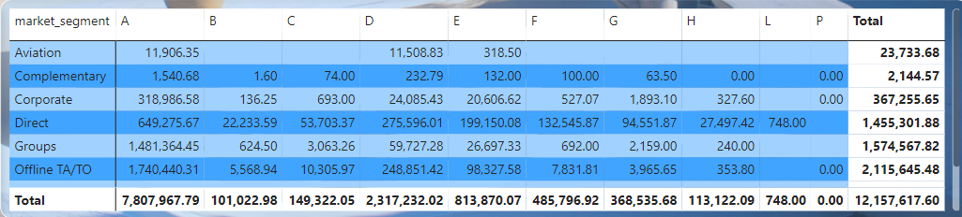
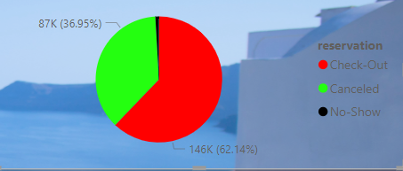
The marginal value (ADR) of the room types assigned depending upon the market segment is approximately Rs.12 crores.
Through the pie chart, we can see the
Reservation made are 62% and cancellation
Made against them are 36%.

Slide 15
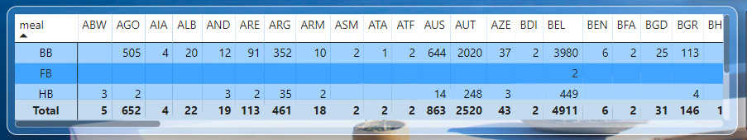
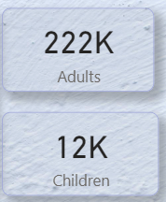
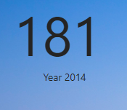
How many people from different countries eat different types of meals in this matrix chart.
Number of adults is 222k and Childers 12K.
The lowest booking were made in 2014 which was 181.

Slide 16
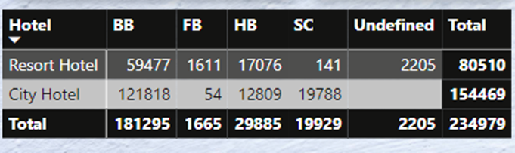
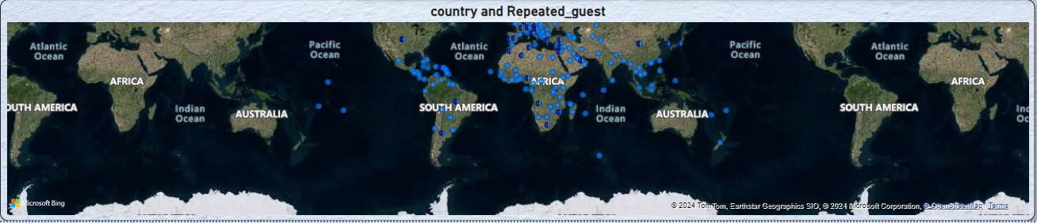
According to the types of hotel, the most common meal consumed is ‘BB’ meal which is 1,81,295 followed by City hotel 1,21,818 and Resort hotel was 59,477.
The highest number of repetitive guest can be seen in this geographical map
that European and Africa is at second number.

Slide 17
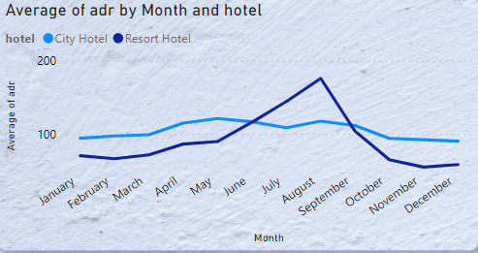
We used the Line chart to check and understand the Average Daily Rate. Chart here represents average of ADR over the months allocated to respective hotel.
Average Daily Rate is a key performance metric in the hotel industry. It is calculated by dividing the total revenue earned from rooms by the number of rooms sold .
It shows fluctuations in ADR for each
month with the Resort Hotel generally
having a higher ADR than the City Hotel,
especially during the summer months.

Slide 18
Conclusion:
Among City hotel and Resort hotels, the demand for city hotel is very high, especially in season like summer .
Country- wise , people from Portugal prefer city hotels the most at 23% followed by Resort hotel at 14%.
If we look at it year by year, the number of people increased rapidly between 2014 to 2016, but that number decreased in 2017.
If we look at the data of the last two years, the number of people staying in city hotel has reduced significantly compared to resort hotel.

Slide 19
We can also say that the reason for the decrease in the number of people is that the marketing was not done that level it should have been because no significant increase was seen in the number of agents in 2017.
Since only a few bookings involve children, it indicates a chance to improve services and marketing to appeal to families.
As August takes the spotlight as the peak month for bookings, hotels ought to fine-tune their promotional efforts and resource distribution to make the most of this peak in demand.
There has been no decline in resort hotel , which means hotel can focus more on resort hotel, which can increase its ADR.

Slide 20
Closure:
Hilton hotel has made a good profit in short time .If hotel wants , it can open more branches.
If the hotel wants, it can bring attractive offers for customers as per a season and on weekends.

Slide 21
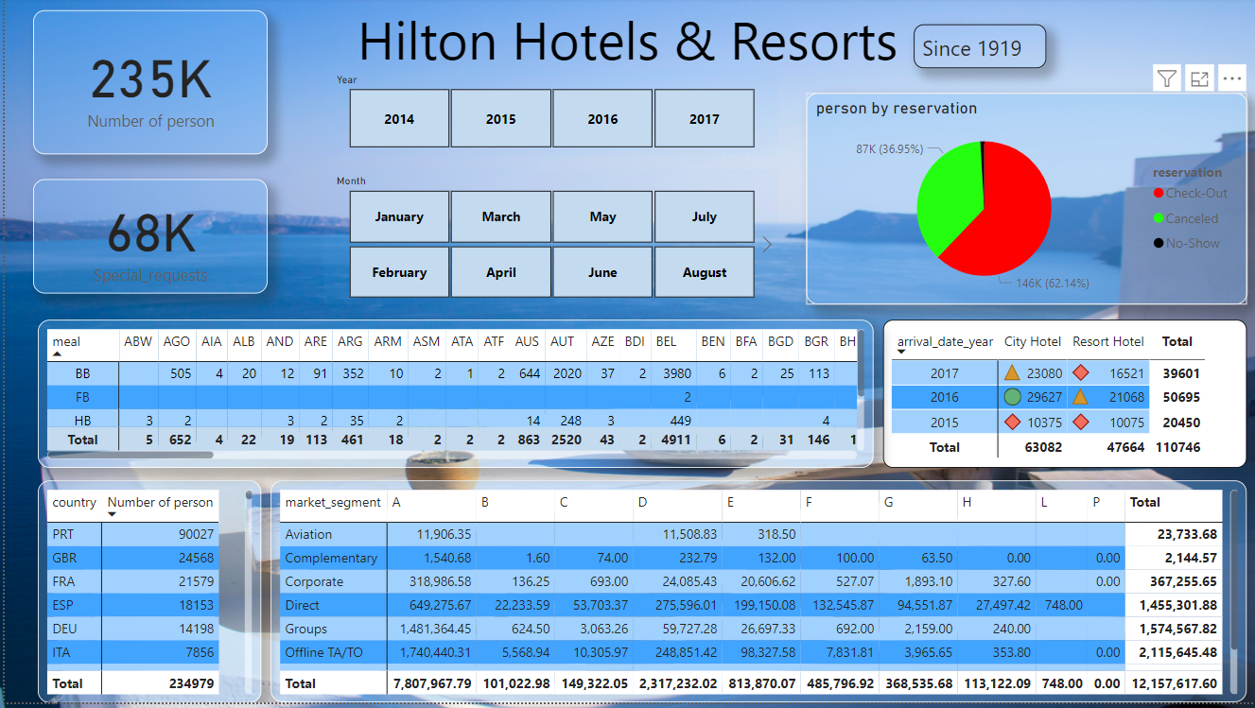

Slide 22
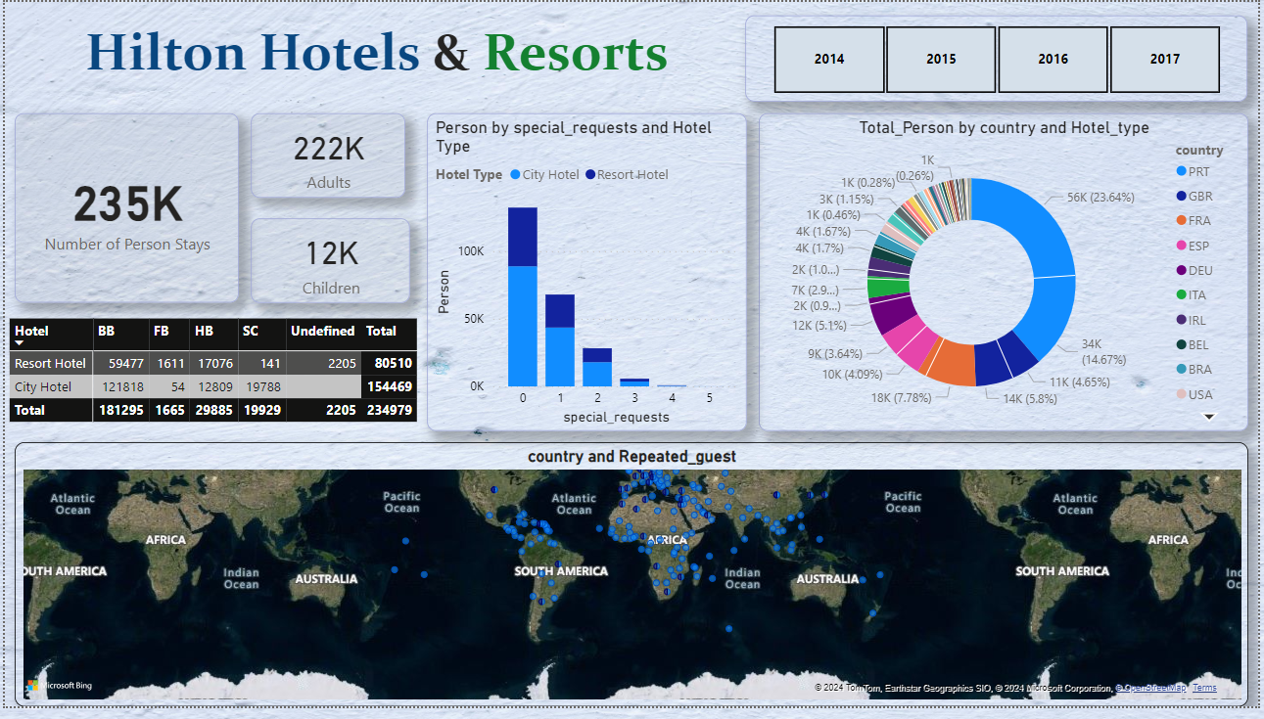

Slide 23
Q&A

